Slide 1
Thinkful Final Capstone
Presented by Jason Paik
Can student enrollment data affect stock price prediction of for-profit education companies?

Slide 2


Passion for education in understanding the attractiveness of for-profit educational institutions - are these legitimate?
Curious to know whether these companies were “successful” - way to measure this is through analyzing the trends in the stock price on market
What features drive this “success”? Does enrollment affect this?
K-12 (online high school) & Grand Canyon University (“GCU”; for-profit university) were my companies of focus

Slide 3
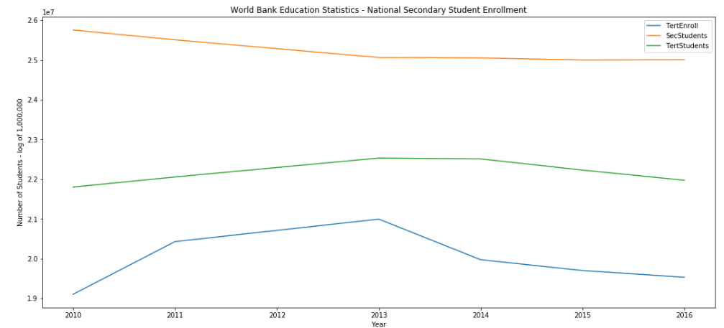
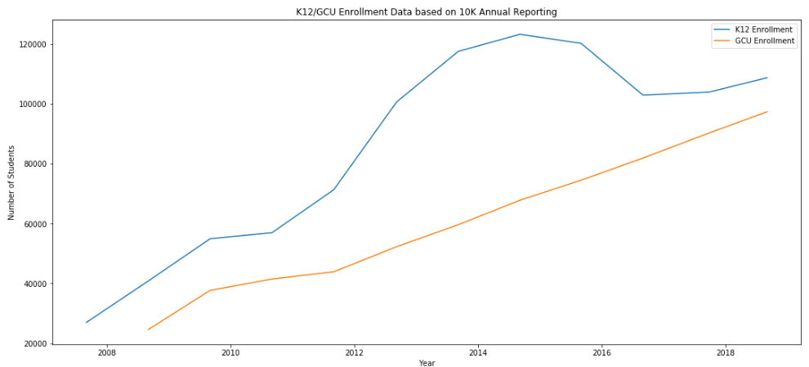
1) What does the market think about enrollment data? Was the stock price ever at all affected by enrollment data?
WBES asserts that enrollment being quite static over the last 7 years
10-K annual reporting from K12 & GCU shows institutional enrollment increasing over last 10 years

Slide 4
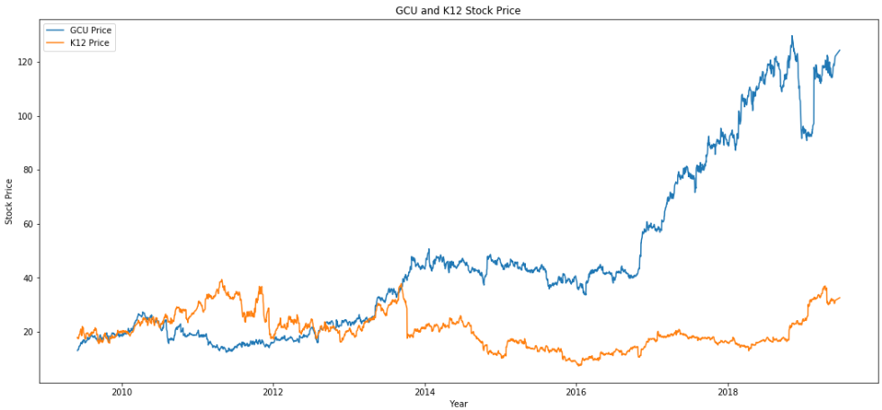
Stock price is quite unaffected by national enrollment figures
Improving institutional enrollment sustains the stability of stock price

Slide 5
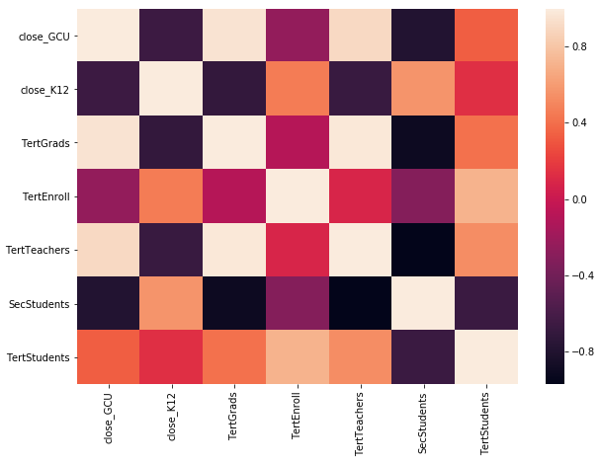
Using a heat map, there are slightly positive correlations between GCU/K12 and student enrollment
Rising enrollment at K12 compared to flat growth of national high school enrollment highlights trending popularity of cyber classrooms - stock price is affected by enrollment in some way

Slide 6
2) Can we predict the stock price of these two academic institutions without the consideration of enrollment data and purely on historical data?
A/B testing lens - a model with just historical stock data and one with additional variables
ARIMA modeling (Unit 6) and time-series analysis to help see this

Slide 7
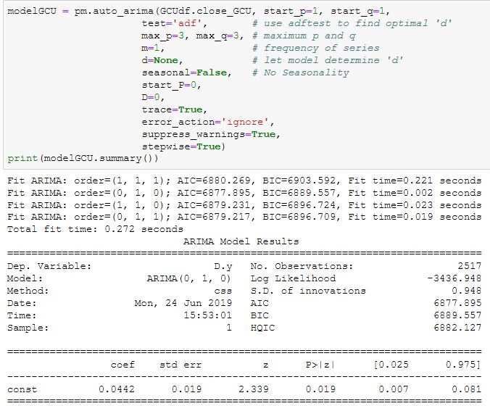
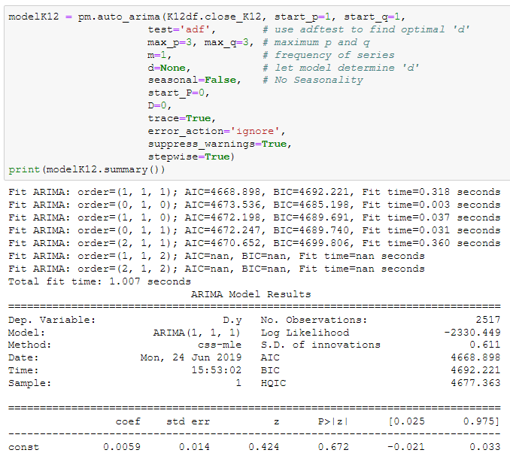
Auto_Arima Python package - helps find lowest AIC score that uses fewer features to achieve same goodness of fit
Used training/test splits taught in course to test ARIMA model

Slide 8
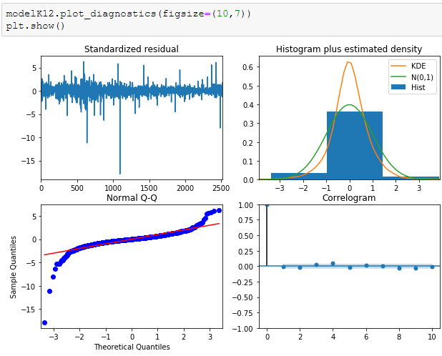
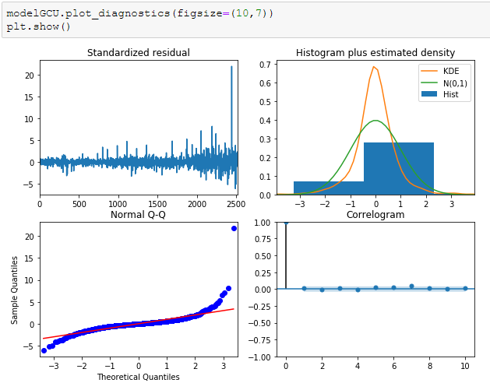
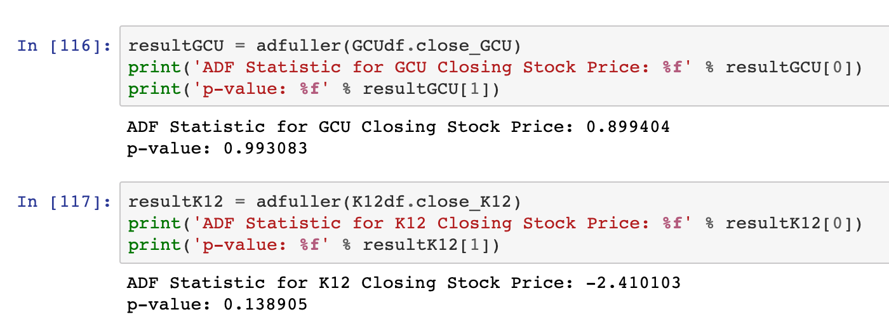
Data is not stationary for robust ARIMA modeling
Standardized Residuals & ADF Stationarity Tests

Slide 9
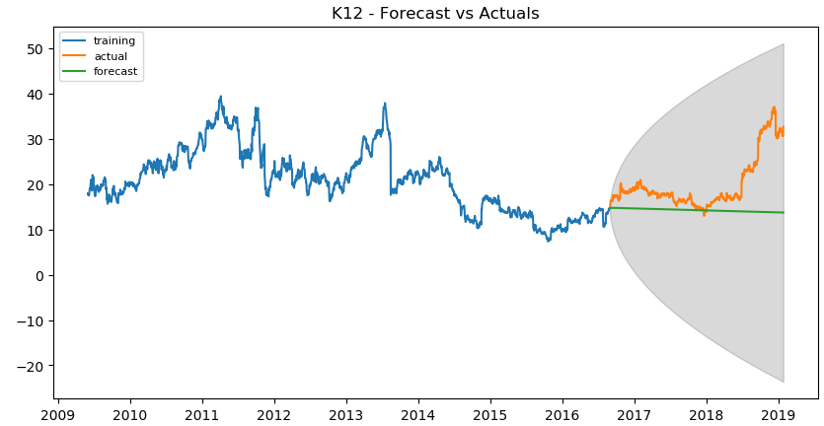
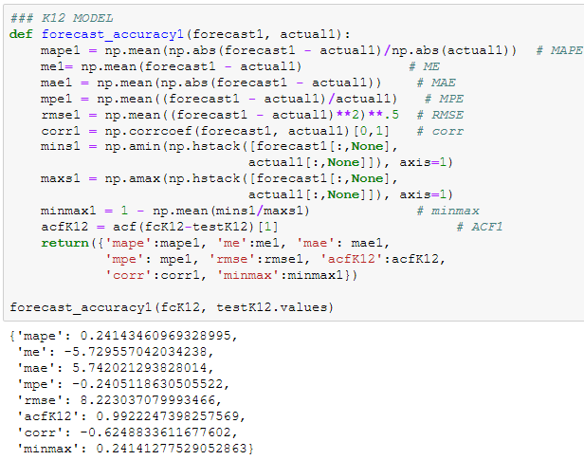
K12 prediction is wide-ranging - stock price can’t go negative either
Mean absolute percentage error: ~76% (mediocre)
Root of mean squared error: 8.22/100 (errors are squared before averaged so RMSE gives relatively high weight to large errors)

Slide 10
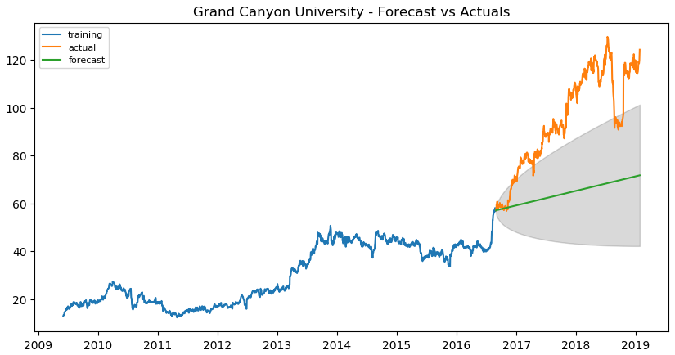
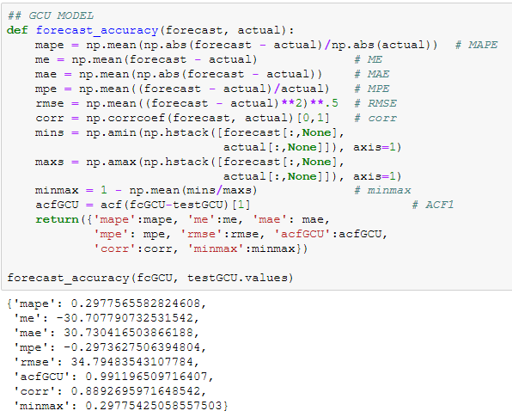
GCU prediction <> what happened in reality
Mean absolute percentage error: ~71% (mediocre)
Root of mean squared error: 34.79/100 (large differences within the errors to predicted values)
Conclusion: Stock price prediction is difficult because it might not pan out to reality - data is non-stationary by nature and actuals are affected by outside variables other than historical data

Slide 11
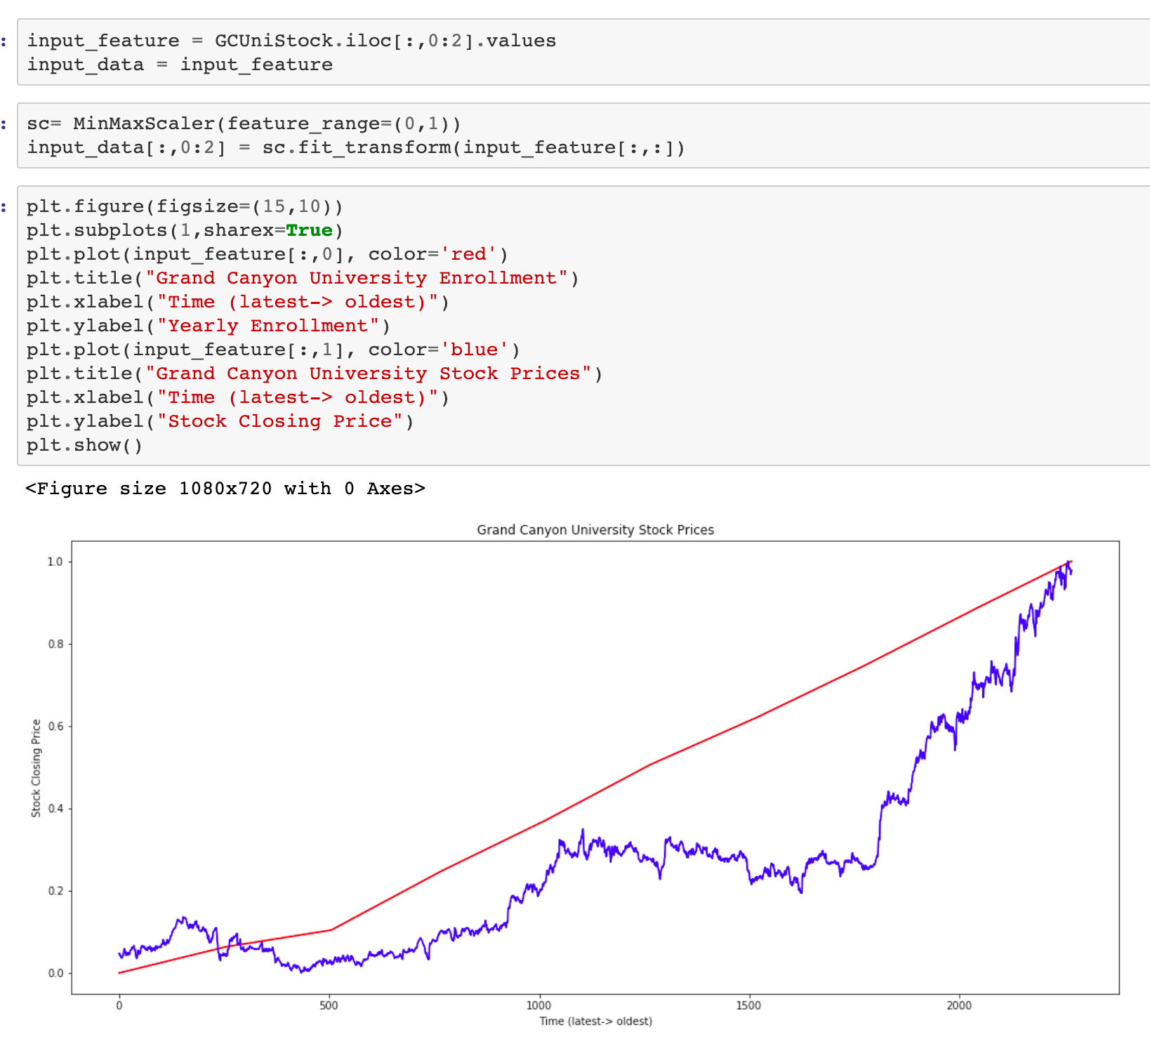
3) Can we take a multivariate approach towards time-series modeling to see if we can predict stock prices based on reported enrollment data?
A/B testing lens - a model with just historical stock data and one with additional variables
ARIMA modeling (Unit 6) and time-series analysis to help see this

Slide 12
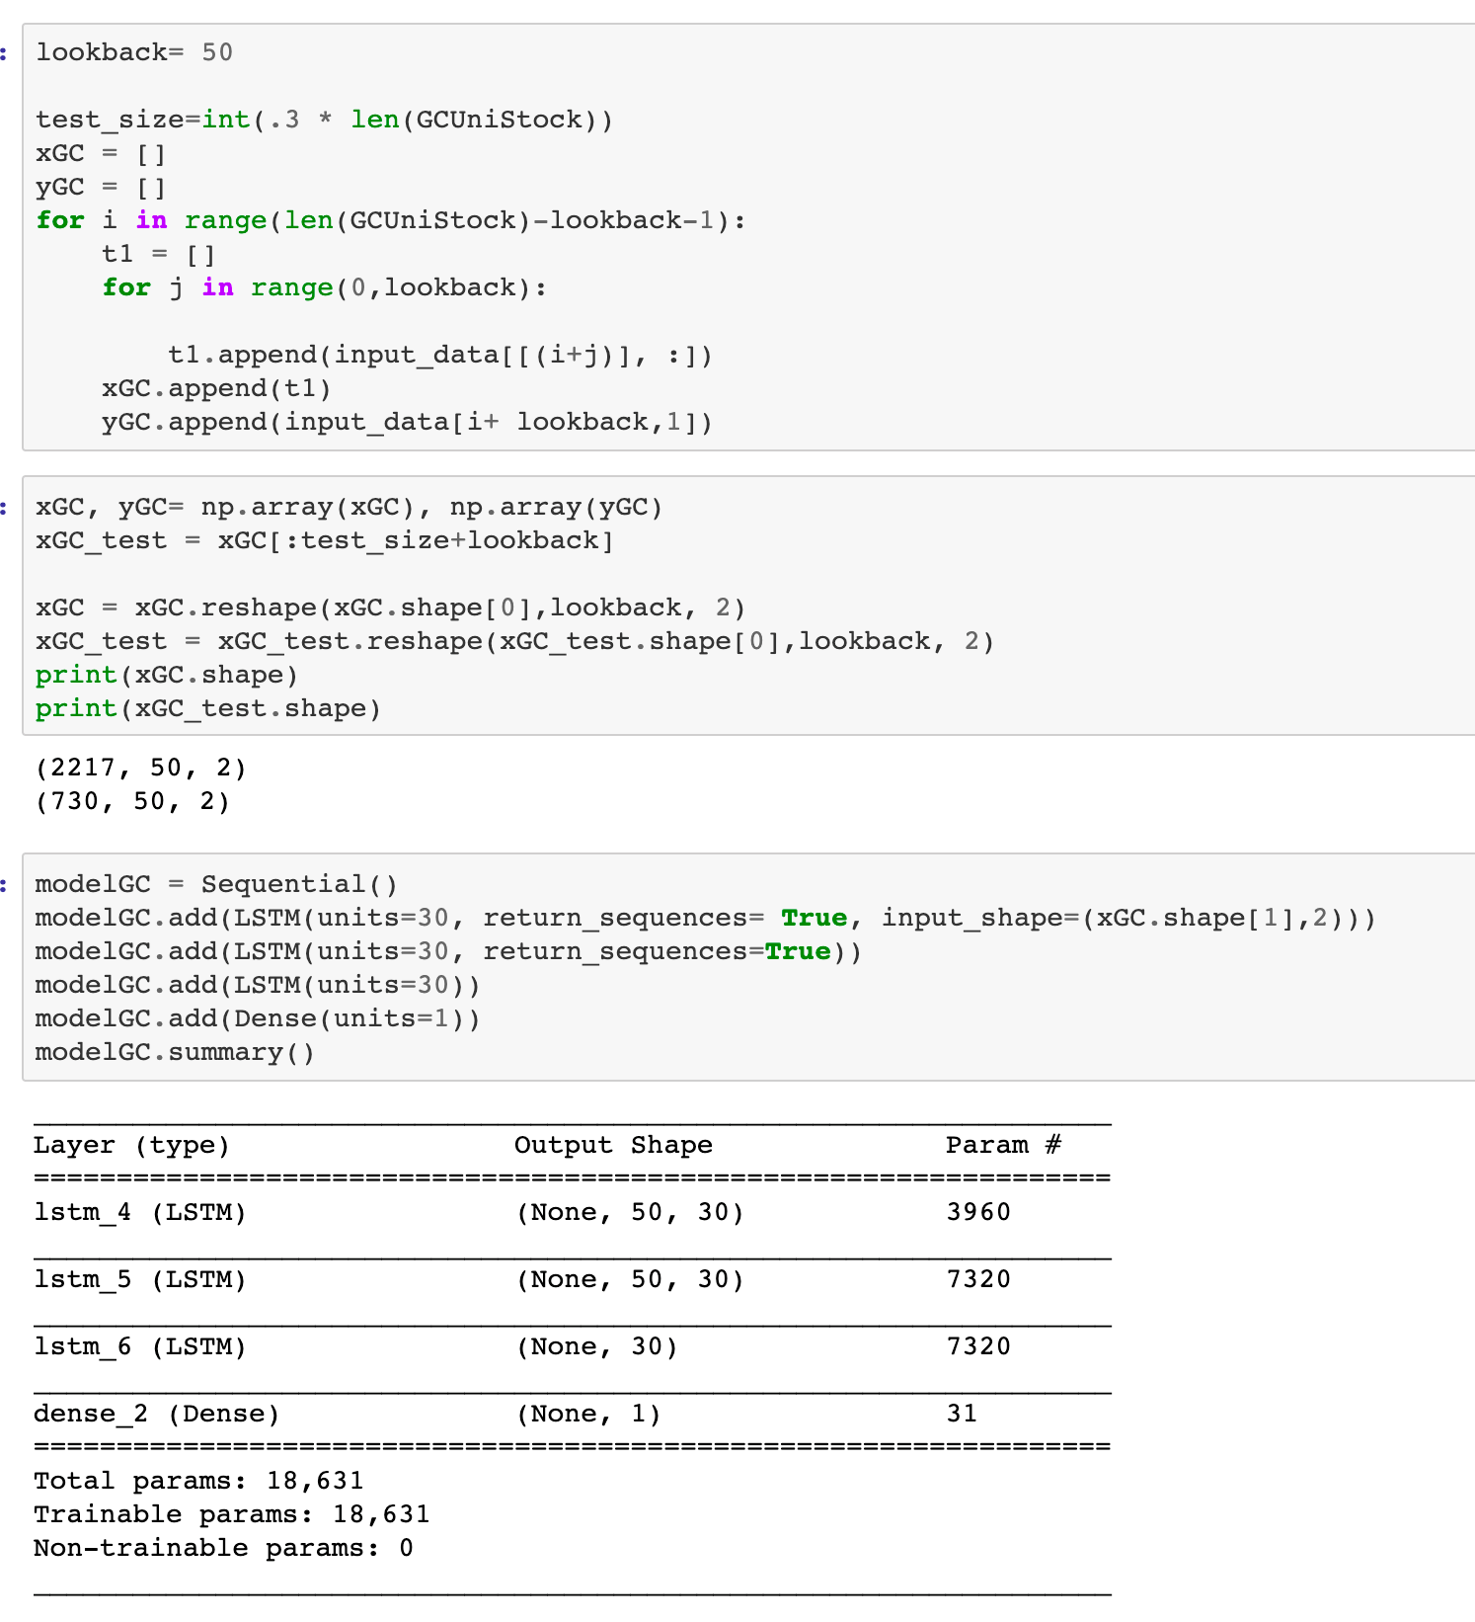

Slide 13
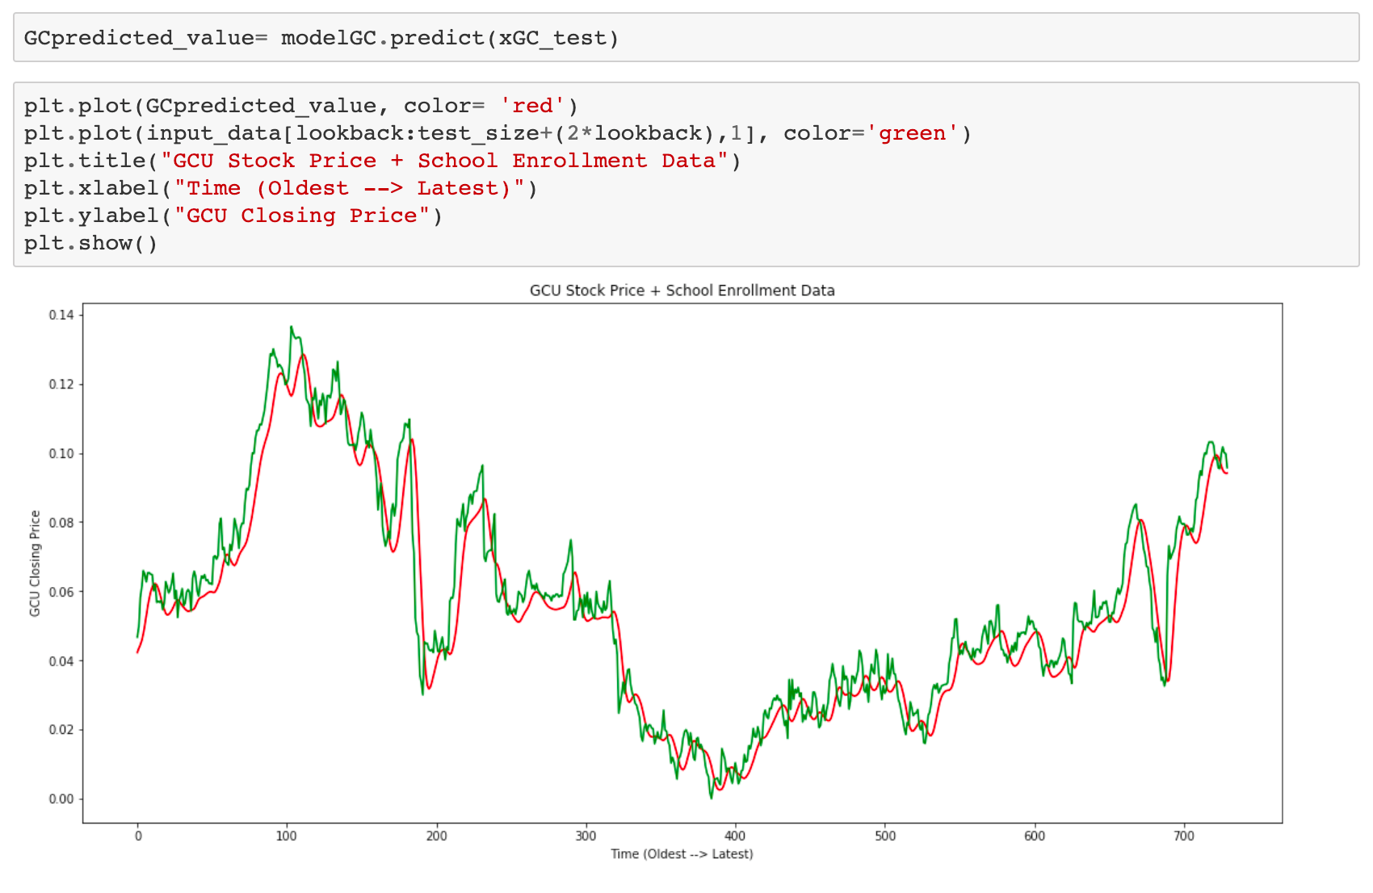

Slide 15
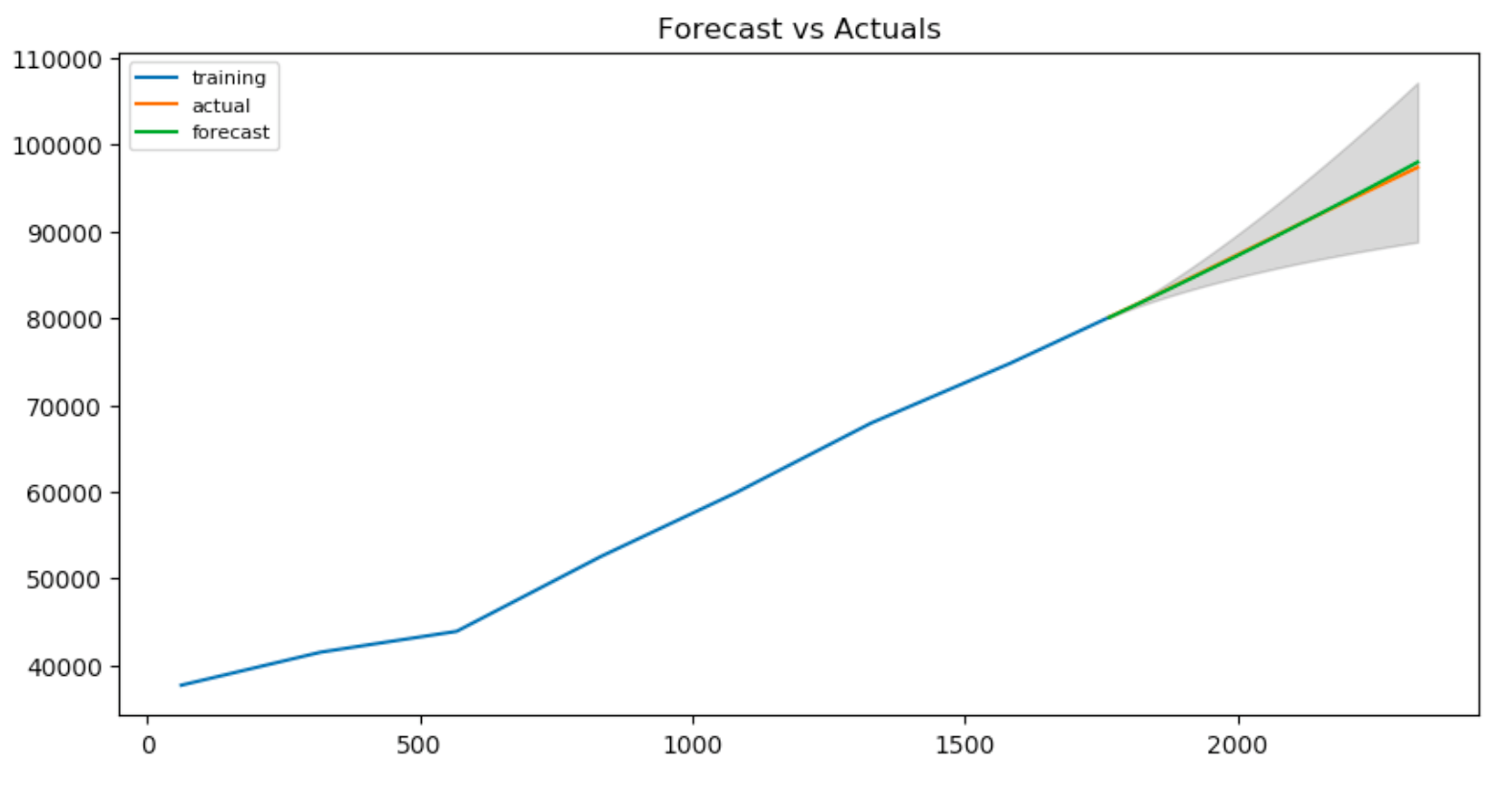

Slide 16
